Slide 1
National Title Company Breakfast Meeting
Division of Real Estate & Professional Licensing
Kimberley Wells, Division Counsel
Shannon Drawns, Enforcement Chief
Division of Financial
Institutions
Zach Luck, Deputy Superintendent
Samantha McCauley, Program Administrator

Slide 2
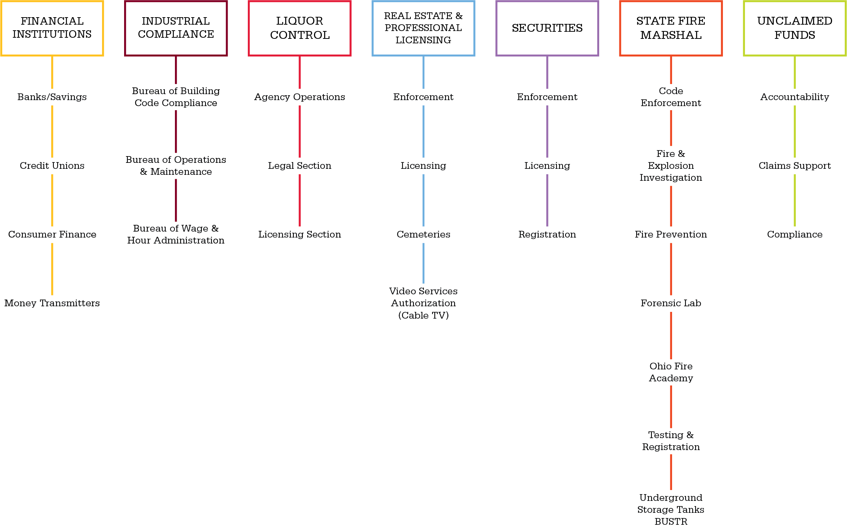
2
Overview of your division, how it plays a role in Commerce as a whole, etc.
The Ohio Department of Commerce is focused on equipping businesses and protecting consumers.
Commerce has seven Divisions.
Our goal is to keep Ohioan’s safe, sound and secure.

Slide 3
3
Division of Financial Institutions – Complaints
Complaint Process
Intake – consumer written complaints
Forward to respondent
Respondent to review complaint and respond directly to consumer
Division review

Slide 4
4
Division of Financial Institutions – Complaints
Total number of complaints per fiscal year (July to June)
Starting in July 2015

Slide 5
5
Division of Financial Institutions – Complaints
Total number of complaints by section of DFI
Credit Unions
BSI (Banks, Savings Institutions and Money Transmitters)
Consumer Finance (Mortgage Lenders, Mortgage Brokers, Payday/Title Loans, etc.)

Slide 6
6
Division of Financial Institutions – Complaints
Top five complaints based on product/service
Checking/savings account
Mortgage
Auto loan
Credit/prepaid card
Payday/title loan

Slide 7
7
Division of Financial Institutions – Complaints
Top five Complaint Topics for Mortgage Related Complaints
Account/Loan Balance
Insurance
Hardship Assistance
Loan or Closing Process
Account/Loan Management (Servicing)

Slide 8
8
Ohio Division of Financial Institutions – Regulations
Proposed Legislation: Ohio Residential Mortgage Lending Act (House Bill 199)
Currently pending in Senate, passed House
Eliminate Dual Licensing of Mortgage Companies and Loan Originators
Currently more than 100 companies and over 5,000 individuals have dual mortgage licenses
Eliminate certain state-specific mortgage disclosures (not all)
Eliminate “brick-and-mortar” requirement for mortgage companies

Slide 9
9
Ohio Division of Financial Institutions – Other Consumer Finance News
Do’s and Don’ts
IT Upgrades - DFI Internal & NMLS
Common Exam Finding: Be Careful with “Compliance in a Box”
Common Licensing Issue: Watch Out for Test Date Expiration on Reapplications
Common Issue: Keep Us Updated – Branch Moves and Contact Info

Slide 10
10
Division of Real Estate & Professional Licensing
Two types of licenses: sales and broker
Process for obtaining a sales license
Completion of Pre-licensure education for sales license:
Real estate law
Principles and practice
Finance
Appraisal
Filing of an application to sit for sales exam

Slide 11
11
Division of Real Estate & Professional Licensing
Broker license requirements
Must have been a salesperson for two out of last five years and have completed 20 transactions
Must complete four additional pre-licensure courses:
Financial Management
Human Resources or Personnel Management
Applied Business Economics
Business Law and a minimum of two years of postsecondary education, or equivalent hours of 60 semester hours or 90 quarter hours (four additional hours may be included in postsecondary education)

Slide 12
12
Division of Real Estate & Professional Licensing –
Do’s and Don’ts of licensure
Do’s:
Complete renewal applications and continuing education timely
Properly complete all applications
disclose ethical history (convictions, investigations, discipline)
Update address with the Division
Provide written notice to the Superintendent within 15 days of a conviction
Maintain transaction files for at least three years from the date of the transaction and cooperate during division investigations

Slide 13
13
Division of Real Estate & Professional Licensing –
Do’s and Don’ts
Don’ts:
Don’t affiliate with more than one brokerage (unless as a principal broker with authority to affiliate with more than one brokerage)
Fail to include broker or management level licensee:
obtain necessary guidance/advice from broker, management level licensee, and/or legal counsel

Slide 14
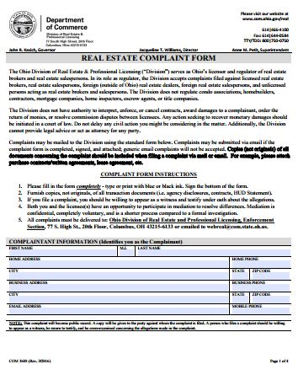
14
Division of Real Estate & Professional Licensing
Complaints
Complaint form is available on the division’s website at: http://www.com.ohio.gov/documents/real_COM3688REComplaintForm.pdf

Slide 15
15
Division of Real Estate & Professional Licensing –
Complaint Process
Investigation, Legal review, Superintendent review
NFA, Advisory
Charges: notice of hearing, settlement
Discipline determined by Ohio Real Estate Commission (OREC)

Slide 16
16
Division of Real Estate & Professional Licensing
Most Common Complaints- Real Estate and Appraiser
Property management
Unauthorized lockbox access
Dispute of earnest money disbursement
Advertising non-compliance
Sales licensee working outside of brokerage (ex. Separate LLC)
Unlicensed activity
Inconsistent or unsupported adjustments
Not reporting or explaining significant assistance
No inspection of subject
Use of inaccurate photographs

Slide 17
17
Division of Real Estate & Professional Licensing – Compliance/Violations
Common Investigations:
Property management deficiencies and unlicensed activity are common
Inquiries related to advertising compliance are common:
real estate teams
equal prominence
authority to list

Slide 18
18
Division of Real Estate & Professional Licensing – Compliance/Violations
Do’s and Don’ts
Do Maintain transactional files
agency documents
contract copies
trust account records
written communication with parties, etc.
Do maintain broker oversight of sales licensees -principal brokers are ultimately responsible for brokerage activities

Slide 19
CLOSED VS. CHARGED

Slide 20
20
Division of Real Estate & Professional Licensing – Compliance/Violations
Do’s and Don’ts
Do obtain all necessary consent and/or signatures/initials from parties to the transaction
Do not advertise as a sales licensee without identifying broker affiliation in equal prominence

Slide 21
21
Division of Real Estate & Professional Licensing – Wholesaling
Option to purchase (commonly utilized)
Intent - does the investor have actual intent to purchase the property?
Advertising - the investor should not advertise the property but the interest held
Do not advertise the property address or photographs of the property
Advertisement should relate to the purchase/assignment of the contract
Other considerations including: licensee vs. non-licensee investor
https://www.youtube.com/watch?v=9fi54S8nwUA

Slide 22
22
Division of Real Estate & Professional Licensing – Regulations
House Bill 532- Real Estate license law changes
https://www.youtube.com/watch?v=Jl0SQsPaZEA&feature=youtu.be
http://www.com.ohio.gov/documents/real_HB532EPI.pdf

Slide 23
QUESTIONS??

Slide 24
What can we do to better serve you?
Zach Luck, Deputy Superintendent
Samantha McCauley, Program Administrator
Kimberley Wells, Division Counsel
Shannon Drawns, Enforcement Chief
WebReal@com.state.oh.us Web.dfi@com.ohio.gov
614.466.4100 614.728.8400
Follow us on Twitter: @OHDIVRealEstate

